Slide 1
BATTLEBOT
Team 3
Capstone 1 Preliminary Design Review

Slide 2
Who are We?
Group members
Ivan Albert
Nishagar Raventhiran
Cole
Advisor
James Black
Course
Capstone 1, EMEC 489

Slide 3
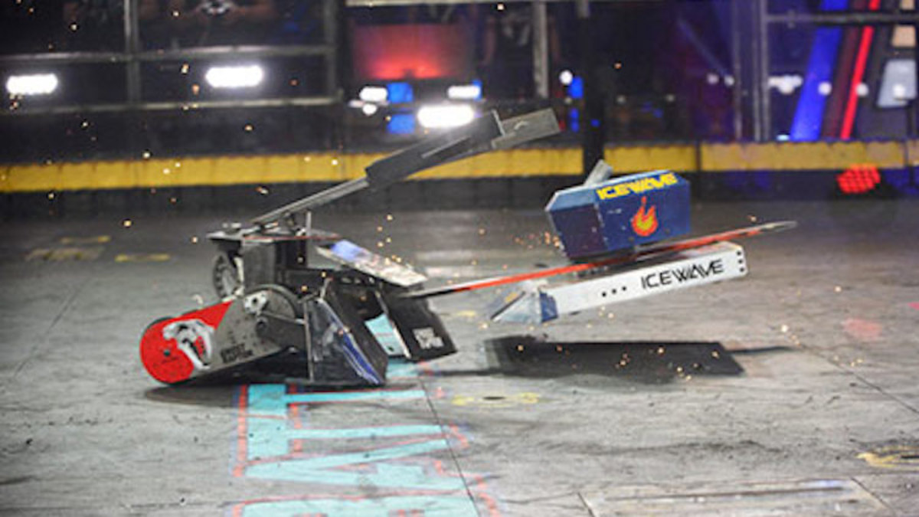
The Competition
Design robot to battle two other opposing robots
Obstacles in the arena
3 rounds of 3 minutes
Attempt to KO other bots
Ready for any weather

Slide 4
Level 1 Requirements
Less than 25 lbs
Fits in 18 in cube
Adheres to weapon limitations (blade, tethered projectile, ⅛ radius, flames, chemical)
Costs less than $1000
Able to run for 3 minutes on one charge
Not a pre assembled robot or toy
Able to run for 3 minutes on one charge

Slide 5
Background
Lessons from televised battlebot competitions
Electrical Controls
Structural Materials
Mobilization

Slide 6
Design Specifications
Design specifications were categorized as follows:
Offensive/defensive Specifications
Assembly Specifications
Interface Specifications
Material Specifications

Slide 7
Offensive/defensive Specifications
Minimum force given by the robot is 20 lb.
Robot must withstand a minimum pushing force of 20 lb as well as 25 lb gravitational force .
Minimum speed of the robot should be 1 ft/s.

Slide 8
Assembly Specifications
Have to have enough battery power to run through whole competition
The turning radius of the robot has to be at least 3 ft

Slide 9
Interface Specifications
The robot must include a master power disconnect switch
Control system must interface with driving motors, and the remote control

Slide 10
Material Specifications
Maximum allowable weight is 25 lb
Must be able to stow into an 18” cube
Radius edge must be have the sharpness less than ⅛”
Keep the cost between $500 and $1000

Slide 11
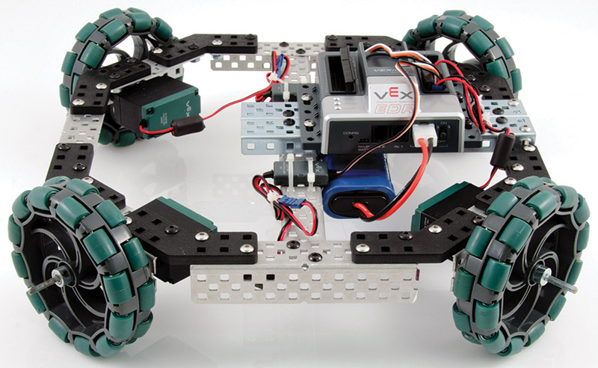
Design Evaluation: Drive System
Drive System | Total Points
Live Axle | 2
Dead Axle: | X
Wheels | 6
Tank Treads | 2
Omni Wheels | 0

Slide 12
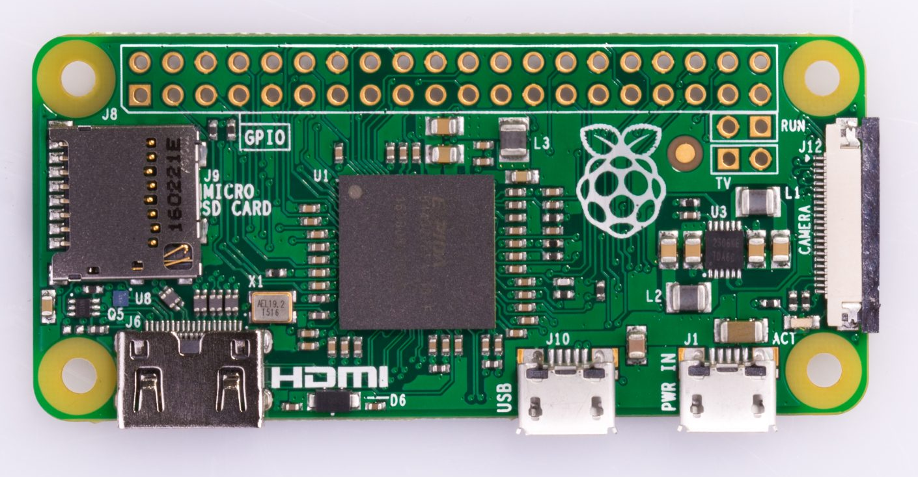
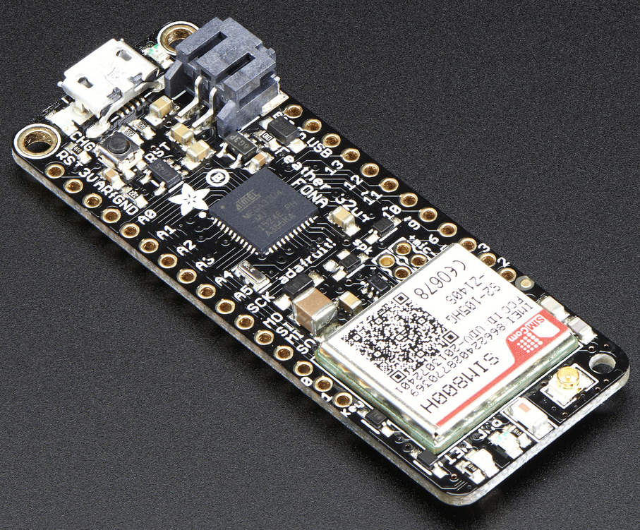
Design Evaluation: Electrical Control System
Electronic Control System | Total Points
Off the Shelf RC Parts | 3
Microcontroller: | X
Bluetooth | 5
Wi-Fi | 3
Radio | 4

Slide 13
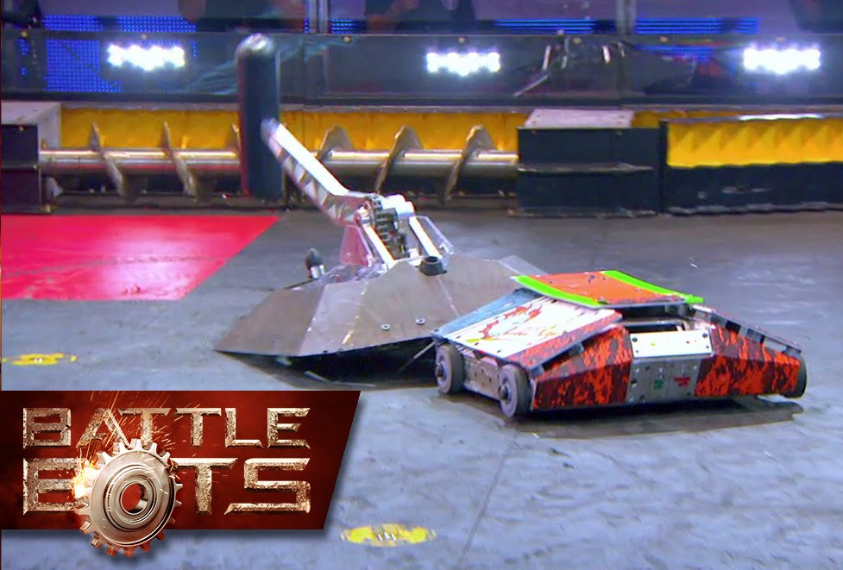
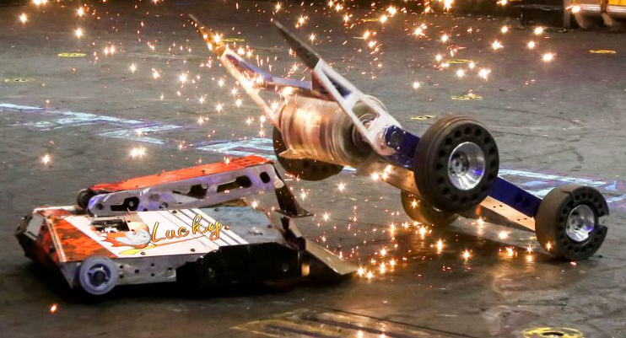
Design Evaluation: Weapon System
Weapon System | Total Points
Hammer | 4
Roller | 5
Hydraulic Wedge | 0
"Hermit Crab" | 2
Spatula | 0

Slide 14

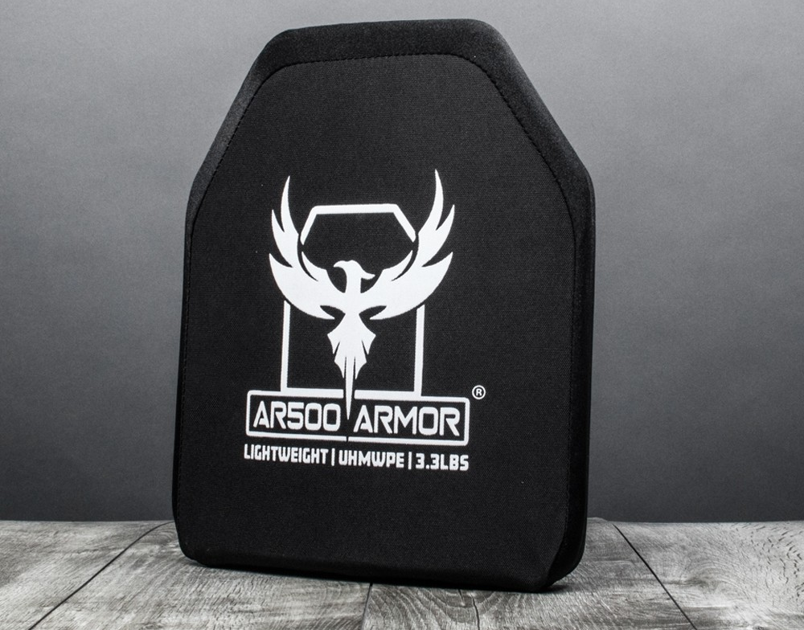
Design Evaluation: Armor
Armor | Total Points
Aluminum | 3
1018 Steel | 2
UHMWPE | 1
AR400 Steel | 0

Slide 15
Design Alternatives
Design | Drive System | Electrical System | Weapon | Armor | Total Points
Design 1 | Dead Axle: Wheels | Micro: Bluetooth | Roller | Aluminum | 19
 | 6 | 5 | 5 | 3
Design 2 | Omni Wheels | Micro: Radio | Hammer | UHMWPE | 9
 | 0 | 4 | 4 | 1
Design 3 | Dead Axle: Wheels | Micro: Bluetooth | Hydraulic Wedge | 1018 Steel | 13
 | 6 | 5 | 0 | 2

Slide 16
Chosen Design
Roller as main weapon system
Wedge in rear
Dead axle drive
Aluminum with layer of Ar400 (where applicable)
Reprogrammable microcontroller

Slide 17
Timeline
November 26: Have CDR presentation ready
November 30: Finish drawings/models/Manufacturing plan
December 3: Complete written report
December 10: Buy materials and components
December 14: Start manufacturing
January: Start programming microcontroller.
March: Integrate subsystems
April: Testing robot
May: Competition day

